Slide 1
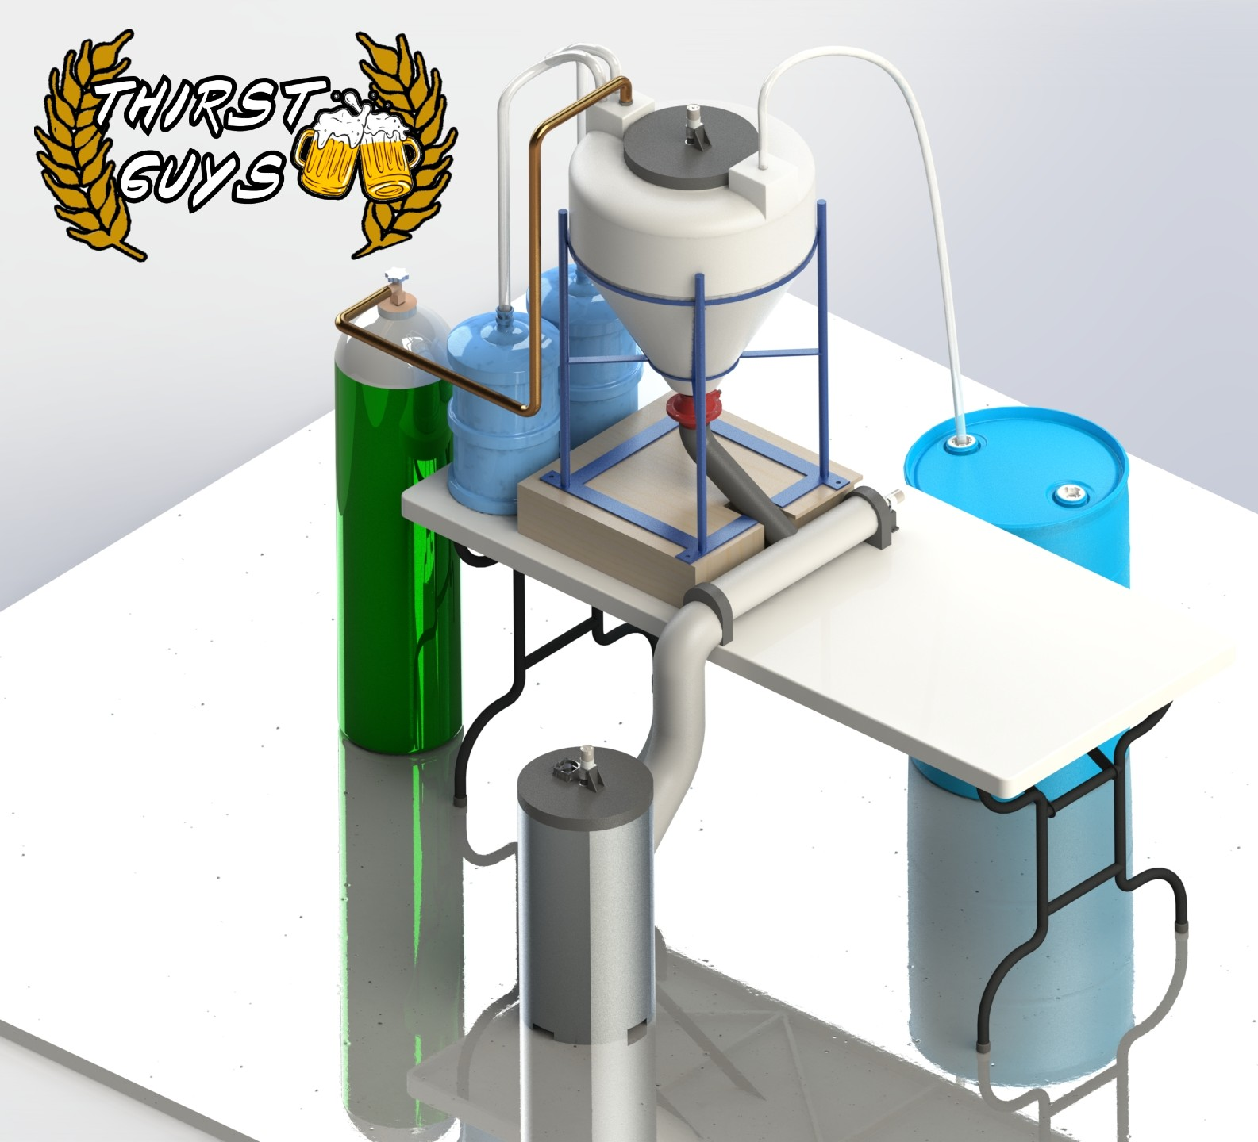

Mechatronics Final Project -
Developing the Multiple-Paged UI for Dynamic Task Handling for Senior MCE Capstone Design Project
By: Raymond Turrisi
18 December 2020

Slide 2
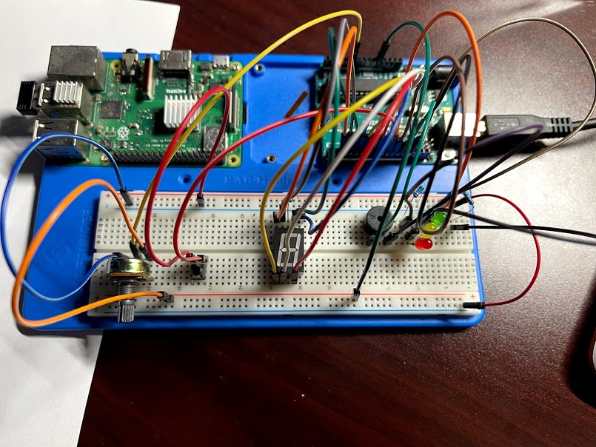
Outline
Overview
Instruction to Implementation
State Transition Structure
Electrical Diagram
User Interface
Recorded Demo
Live demo and Questions
12-18-2020 Raymond Turrisi - MCE 433 Final Project Fa’2020
2/14
Notes:
Done using partial differential equations
Takes the model divides into smaller region to create mesh
CAE uses calculations to solve for the desired parameters

Slide 3
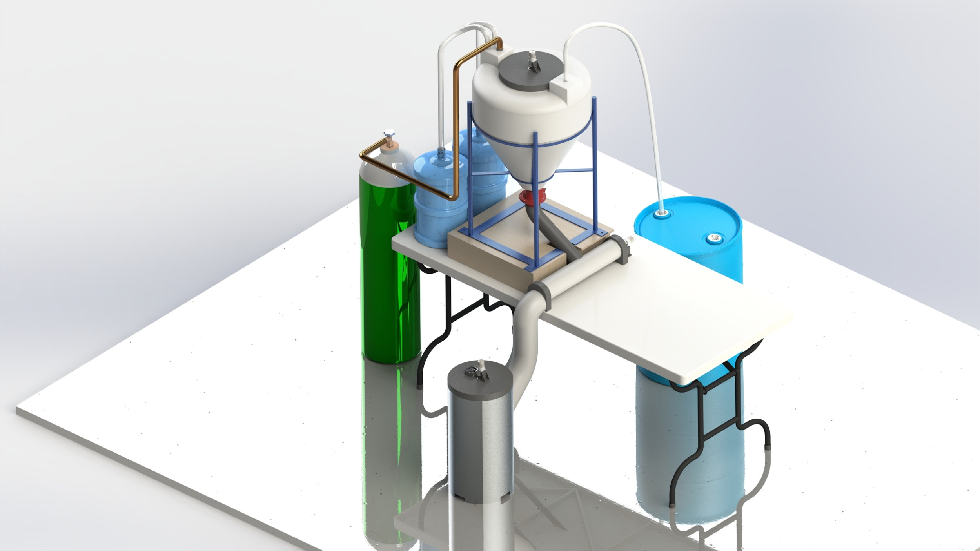
Overview (1)
Fig. 1: Rendering of Team 20H’s Capstone Design Projects Proof of Concept.
12-18-2020 Raymond Turrisi - MCE 433 Final Project Fa’2020
3/14

Slide 4
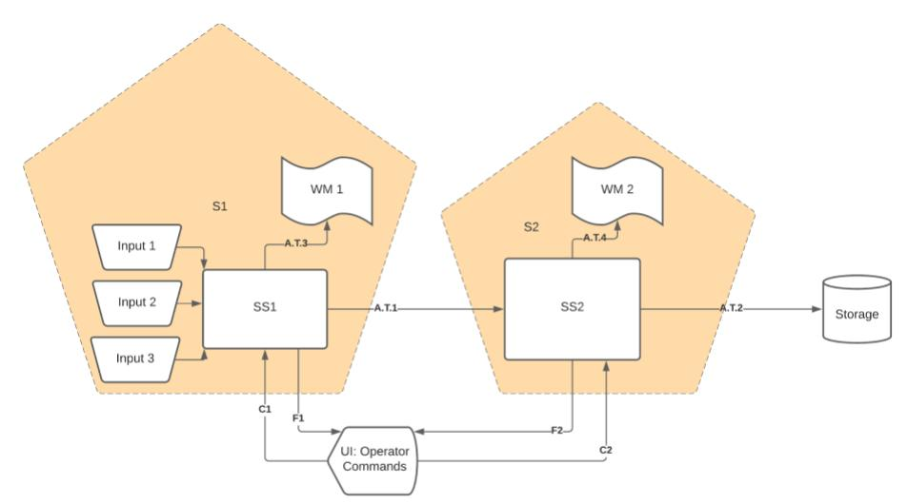
Overview (2)
Fig. 2: Systems Diagram for the Automated Malting System.
12-18-2020 Raymond Turrisi - MCE 433 Final Project Fa’2020
4/14

Slide 5
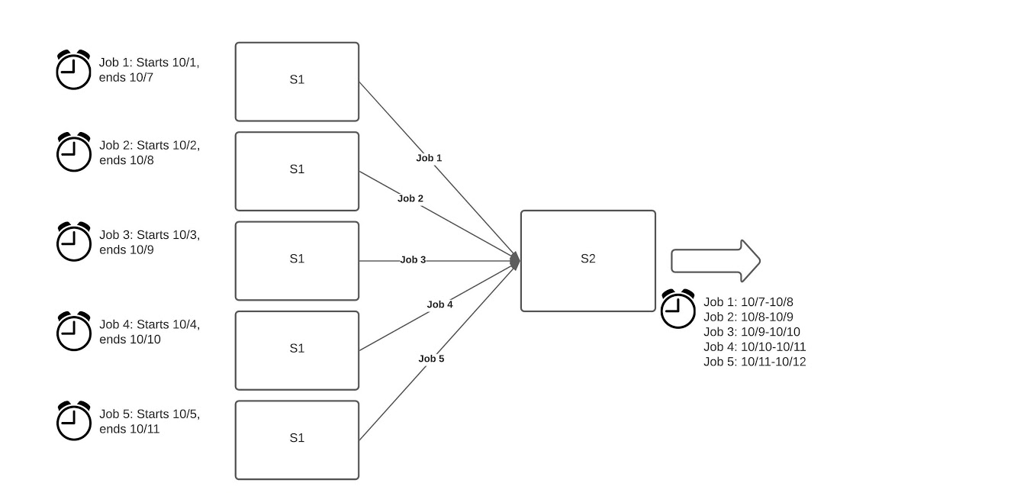
Overview (3)
Motivation?
Fig. 3: Distributed task diagram depicting the use of queues and dynamic task handling.
12-18-2020 Raymond Turrisi - MCE 433 Final Project Fa’2020
5/14

Slide 6
Instructions to Implementation (1)
The use of a microcontroller and PC platforms to implement the code processing for the project.
The use of state transition diagrams to design the control software for the project. The code operation should not be trivial. Use the requirements for the Tank Control Extension as suggestions for features to include in your project.
The project operation should include at least 3 of the following operations: A/D conversion, PWM actuation or D/A conversion, timing, and digital input/digital output.
A/D conversion: Potentiometer input which controls the rate of heating within the temperature simulator
PWM actuation: This is implemented within the glowing red LED whoms luminosity is proportional to the error between the actual and desired temperatures. It doesn’t glow when there is a small error.
Timing: Timing is used extensively for the simulation, the states for the LEDs, and the states for the buzzer.
Digital Input: This is used in the button which pops the current job from the queue.
Digital Output: This is found in the Seven Segment Display
12-18-2020 Raymond Turrisi - MCE 433 Final Project Fa’2020
6/14

Slide 7
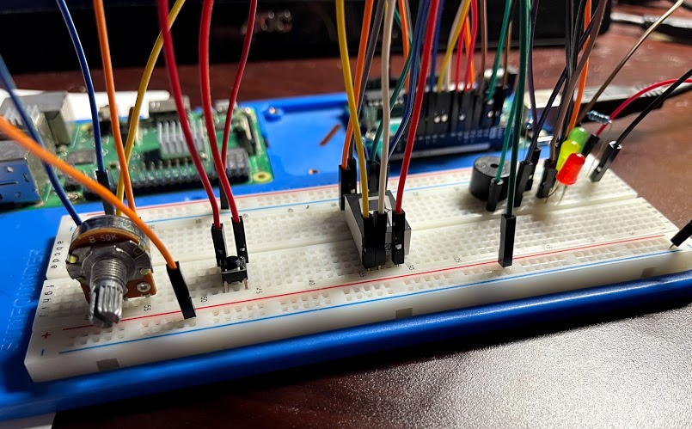
Instructions to Implementation (2)
4. Your project should include at least three different electronic components such as transistors, diodes, logic gates, LEDs buzzers, or other circuit elements such as switches or relays.
1 x Arduino
3 x LEDs
1 x Buzzer
1 x Button
1 x Seven Segment Display
1 x potentiometer switch
2 x resistors
Fig. 4: Electrical Hardware
12-18-2020 Raymond Turrisi - MCE 433 Final Project Fa’2020
7/14

Slide 8
Instructions to Implementation (3)
5. Use of serial interfacing to communicate between the PC and the microcontroller.
Implemented as full duplex serial communication with mutual parsing within both programs.
6. Add a plot to dynamically show your controlled variable or control action during the last 60 seconds
This is completed under the View Log tab.
Additional Comments:
Yellow LEDs indicate if the height is above or below the water level mark ⮞Red LED illuminates proportional to the error
5 Additional LEDs to indicate tank height ⮞ Yellow and Green LEDs illuminate w/rt % of job complete
Green LED flashing every 1 second when tank is dispensing the fluid ⮞Yellow LED is blinking when there are no jobs in the queue
Use a buzzer which turns on the first time the tank reaches the desired height in auto mode ⮞ buzzes for 4 seconds when job is complete
Use a buzzer to issue four separate short beeps whenever the tank is in on mode ⮞ Beeps twice whenever a new job is loaded into the queue
Use a potentiometer to control filling rate and display on UI ⮞ Potentiometer controls heating rate and is displayed in the notice box on the home screen
12-18-2020 Raymond Turrisi - MCE 433 Final Project Fa’2020
8/14

Slide 9
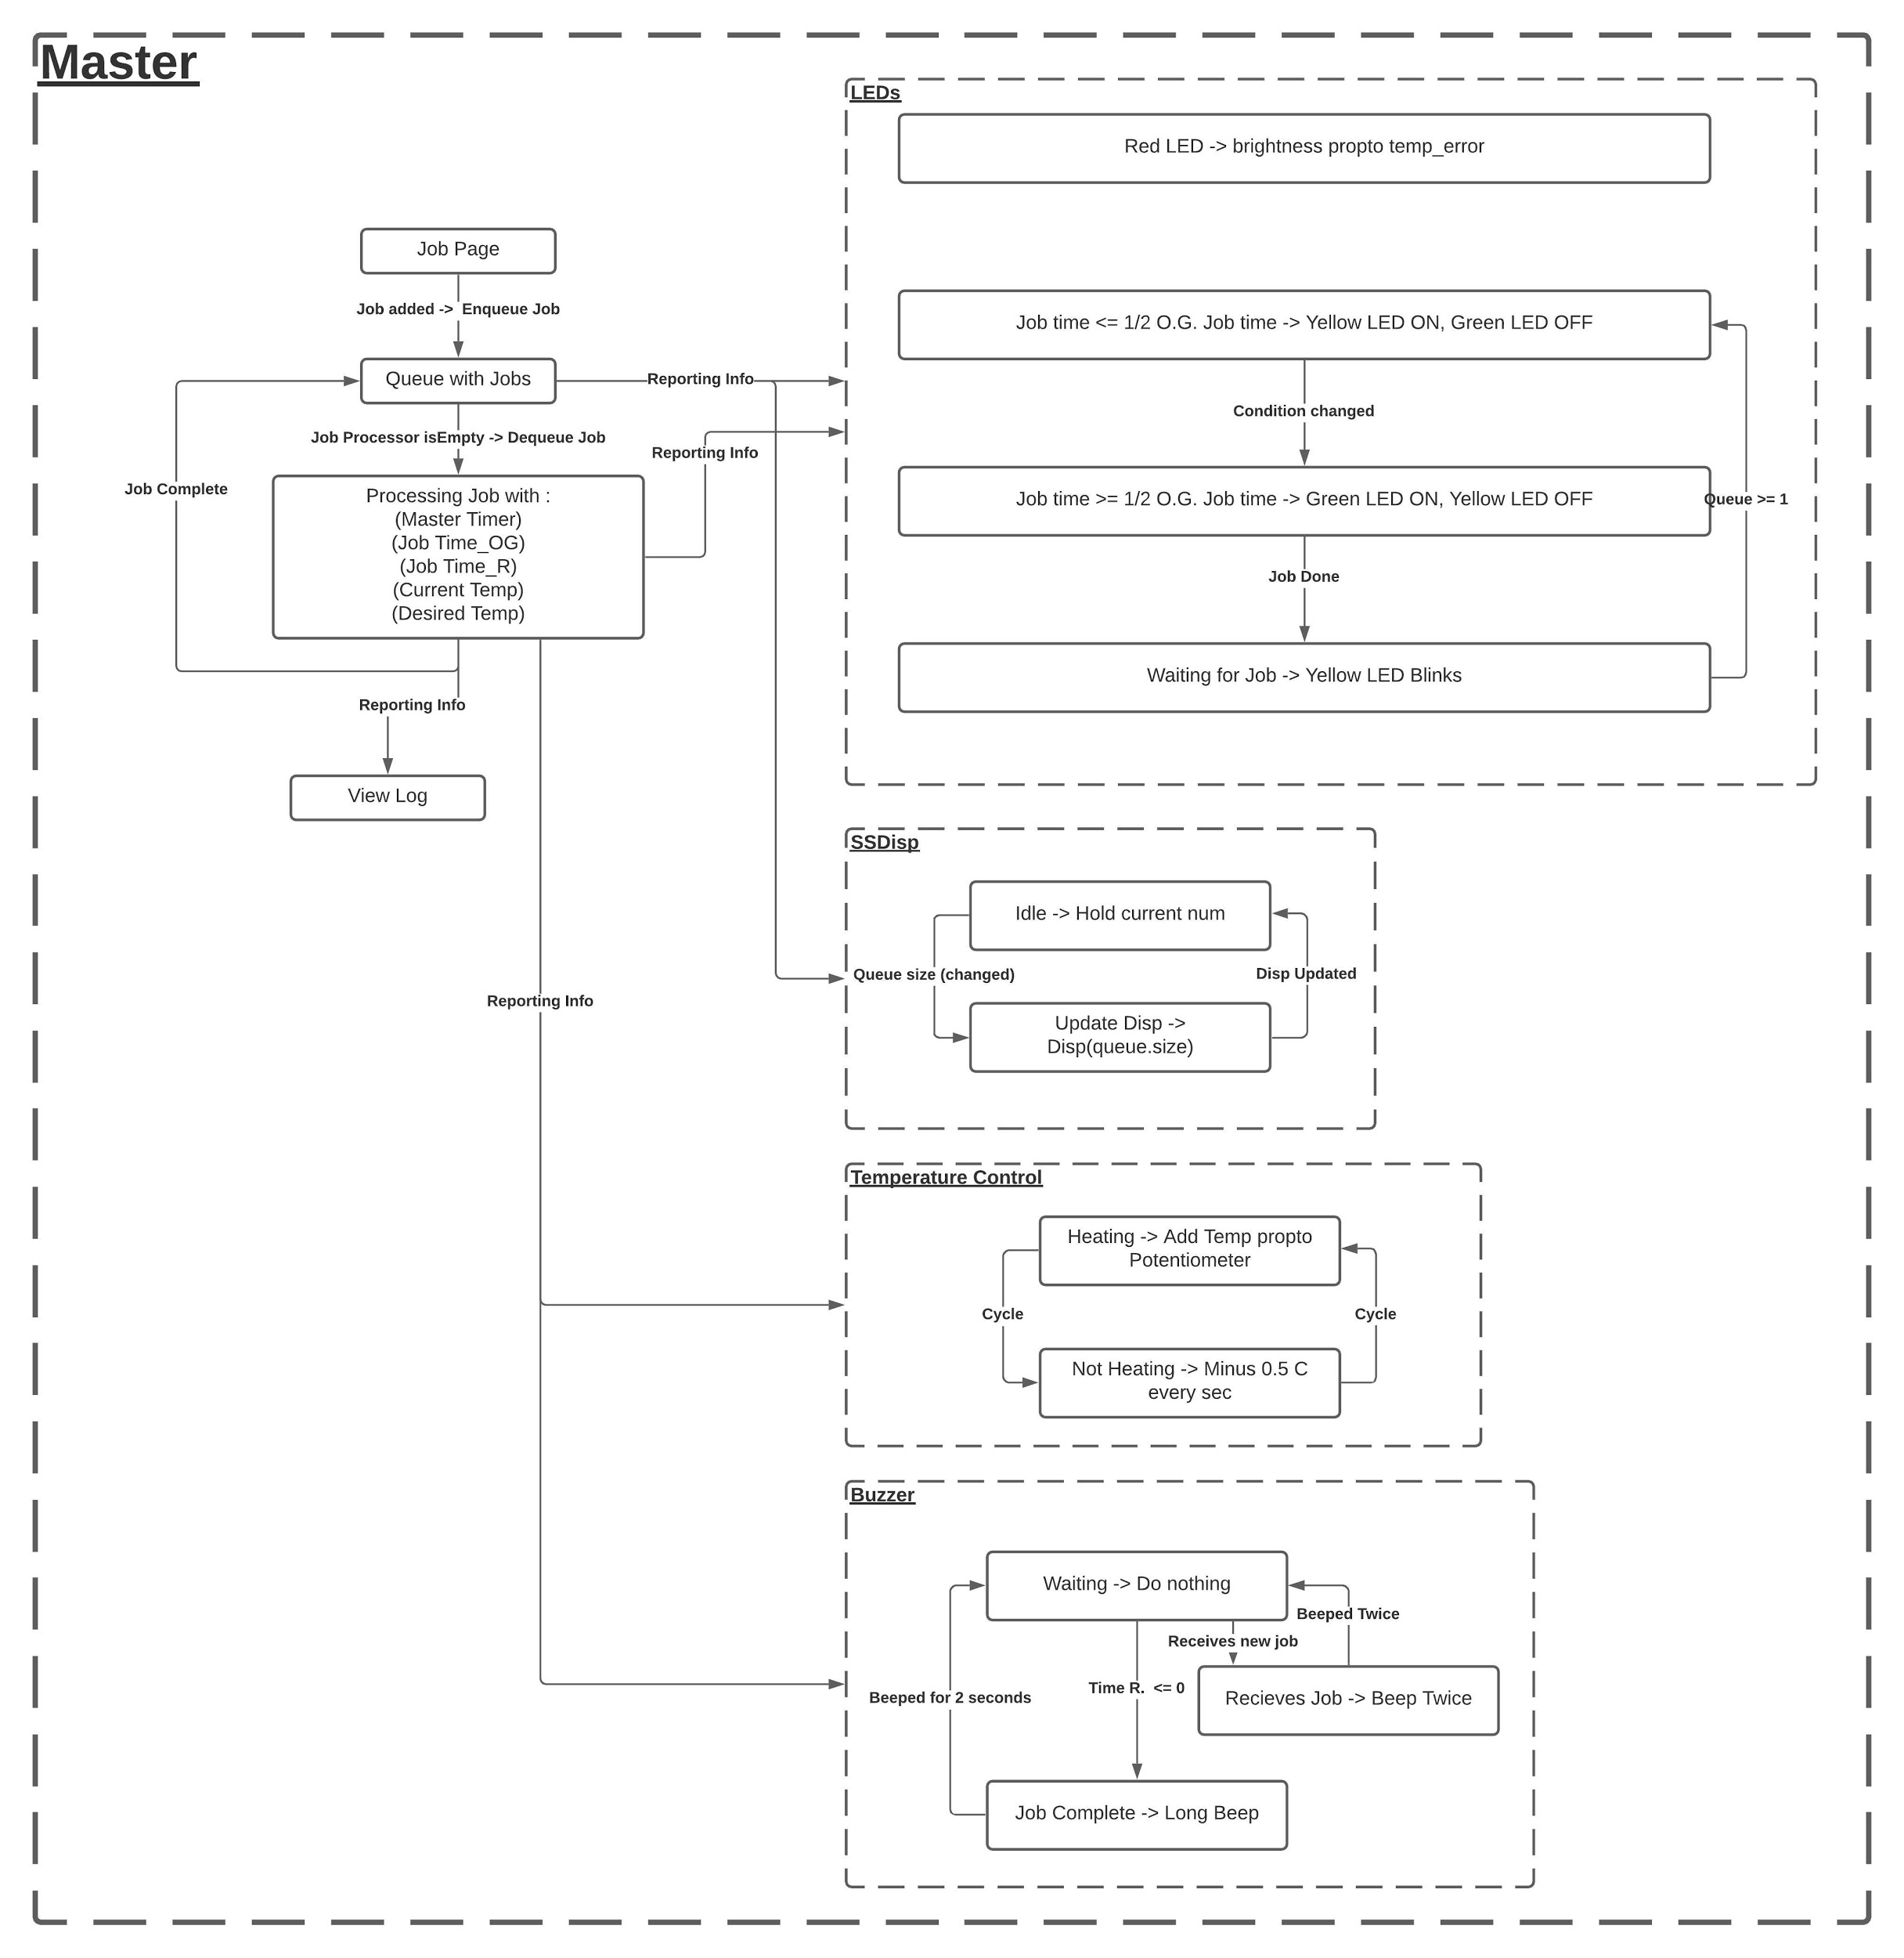
State Transition Diagram (1)
Fig. 5: State Transition Diagram.
12-18-2020 Raymond Turrisi - MCE 433 Final Project Fa’2020
9/14

Slide 10
State Transition Diagram (2)
Fig. 6: Isolated state transition diagrams.
12-18-2020 Raymond Turrisi - MCE 433 Final Project Fa’2020
10/14

Slide 11
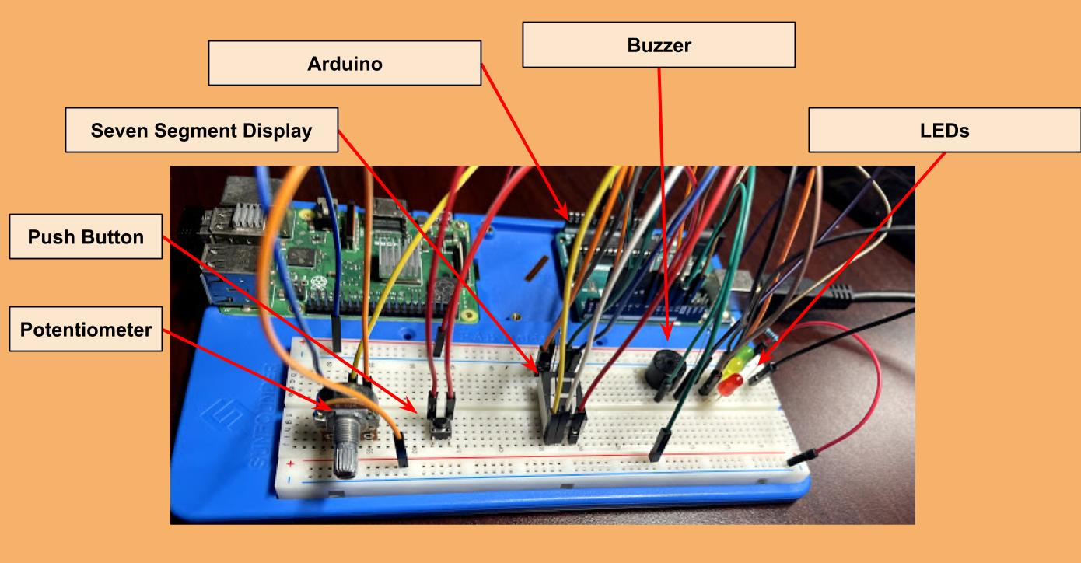
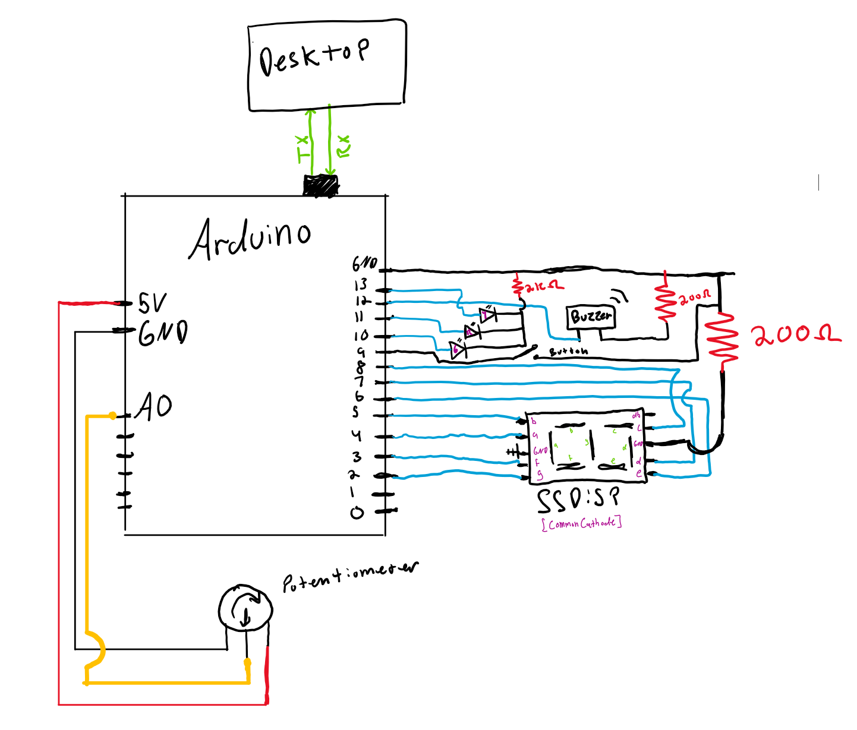
Electrical Schematic
Fig. 8: Electronics diagram
Fig. 7: Labeled photo of breadboard housing electrical components.
12-18-2020 Raymond Turrisi - MCE 433 Final Project Fa’2020
11/14

Slide 12
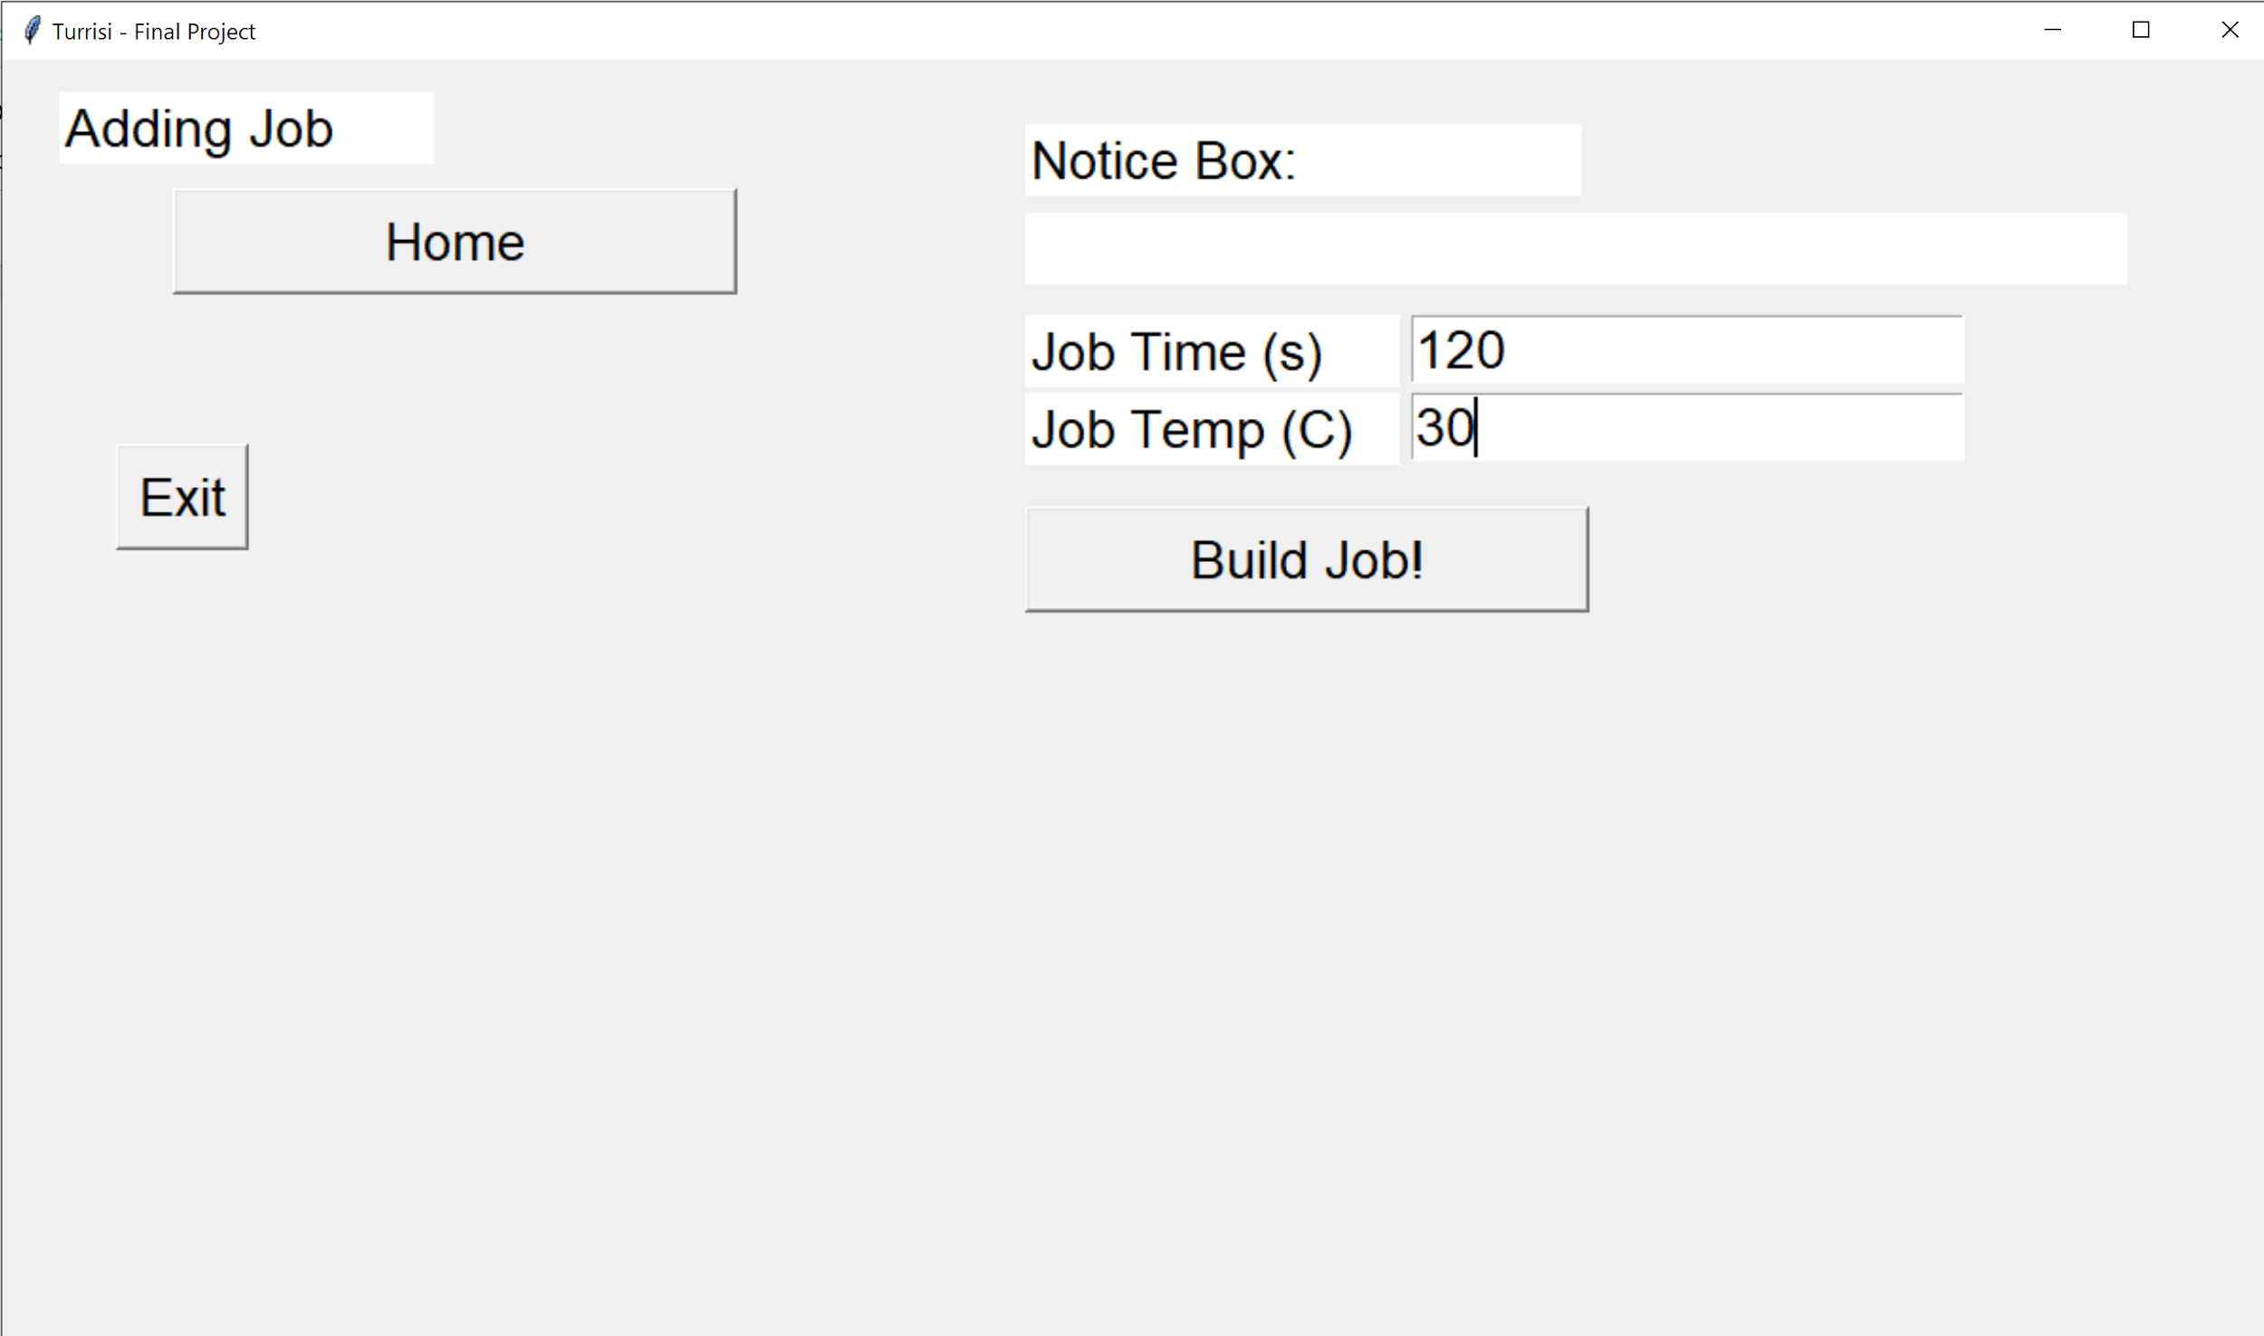
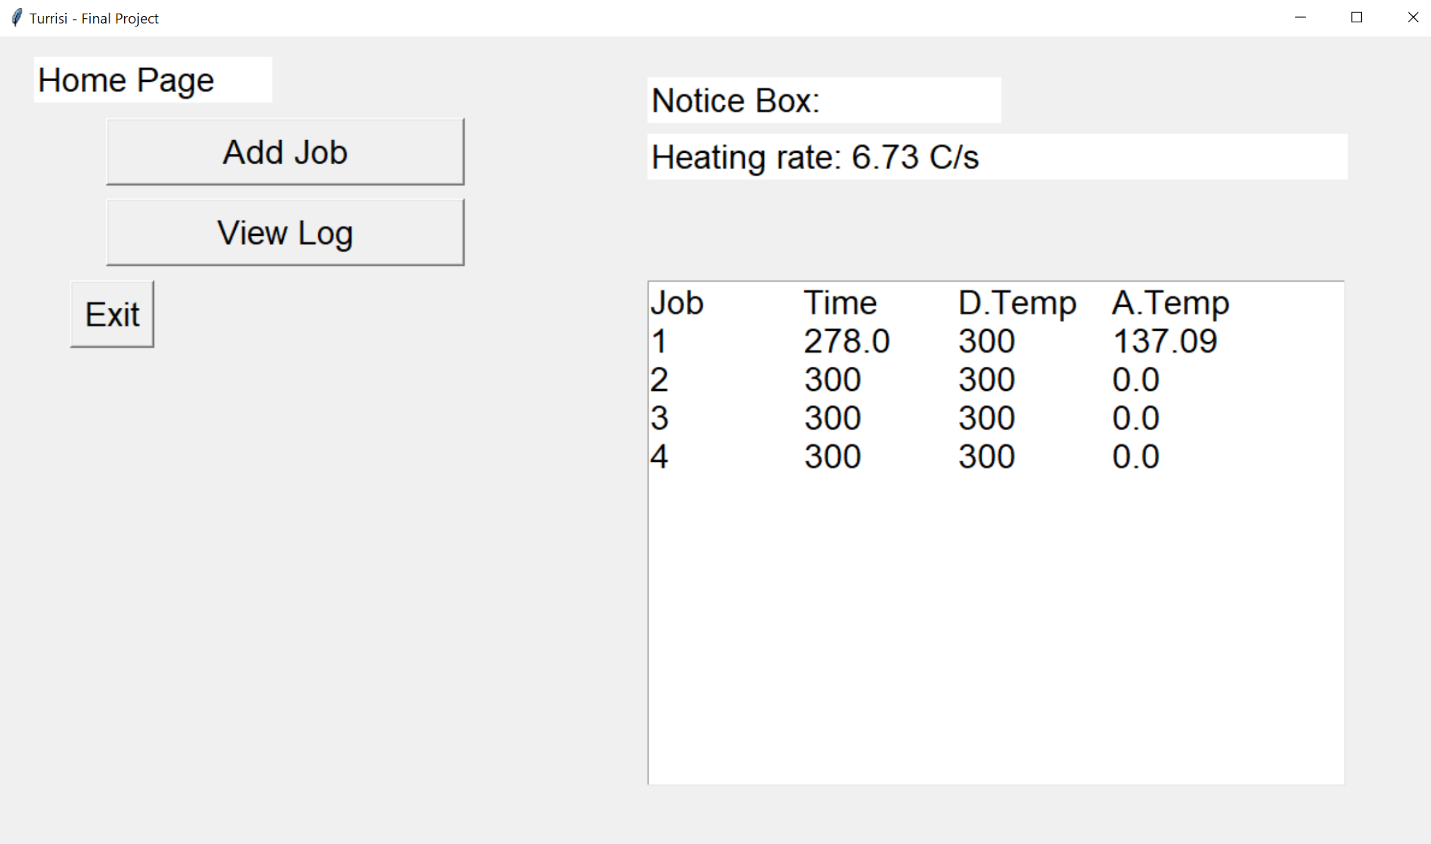
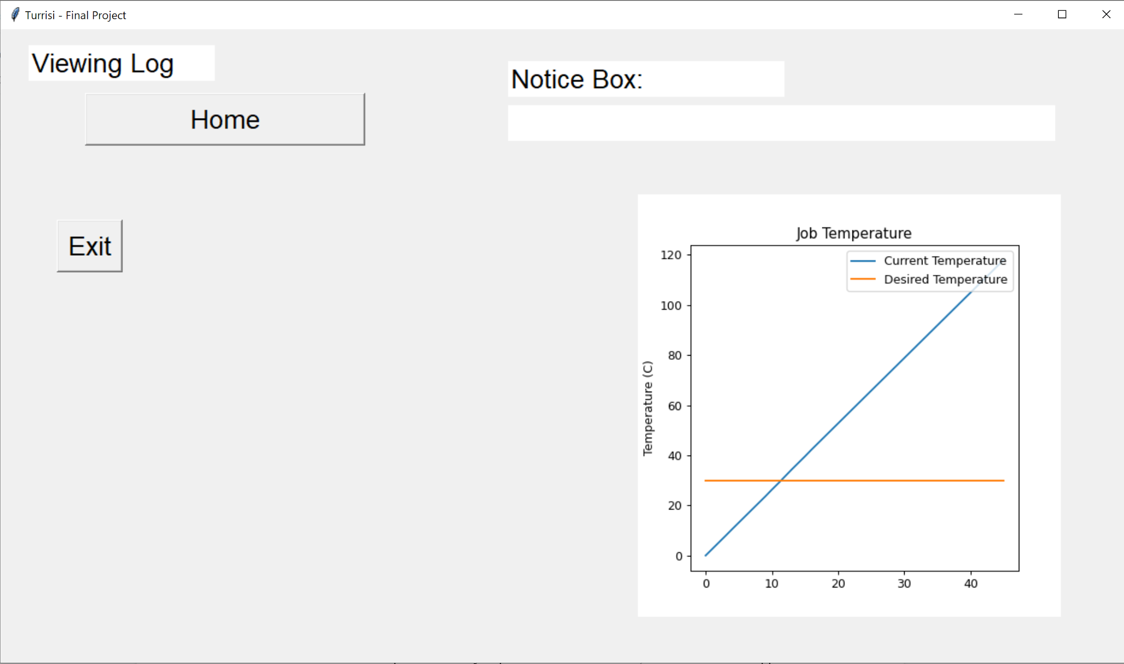
User Interface
Fig. 10: Three pages of user interface.
12-18-2020 Raymond Turrisi - MCE 433 Final Project Fa’2020
12/14

Slide 13

Recorded Demo
12-18-2020 Raymond Turrisi - MCE 433 Final Project Fa’2020
13/14

Slide 14
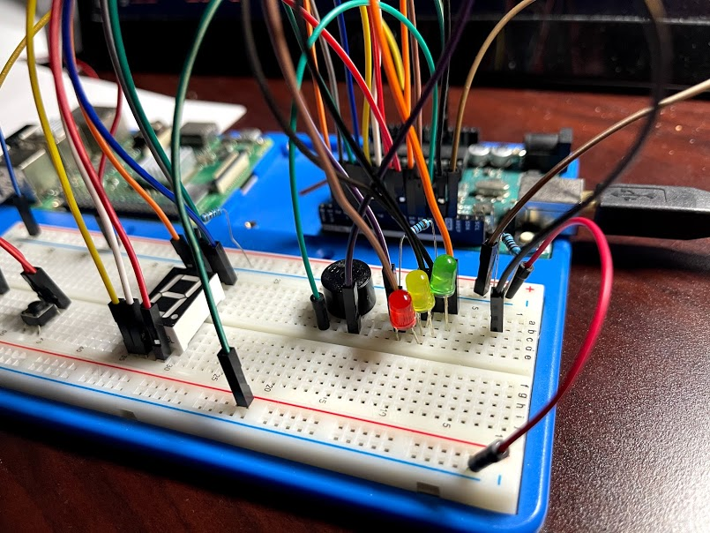
Live Demo & Questions
Questions?
Live Demo?
Python Code?
Arduino Code?
Electronics?
User Interface?
State Transition Diagram?
Entry code structure!
Electronics Diagram?
Fig. 11: Electrical Hardware.
12-18-2020 Raymond Turrisi - MCE 433 Final Project Fa’2020
14/14

